Slide 1

Python Fundamentals
Innovation Masters
Day 8

Slide 2

Today’s Agenda
Finish loops
Review of String indices
Make the index and count method
Make vowel counter
Play with turtle
Tech Talk - Gene Editting

Slide 3
Indices of string
Strings are a collection of characters like we said before.
Each character has an index number.
Index numbers start from zero
Let’s look at the index method

Slide 4
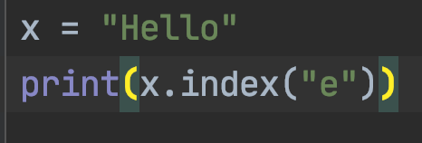
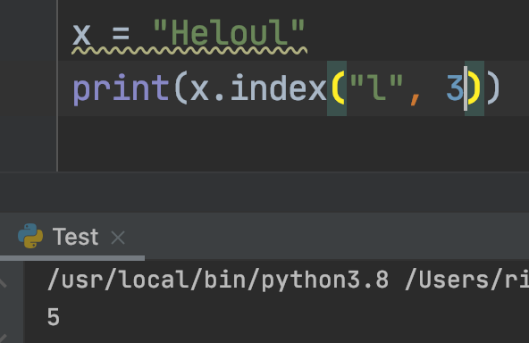
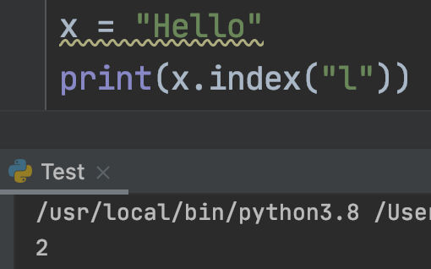
Index method
1

Slide 5
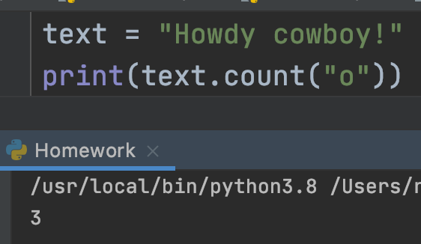
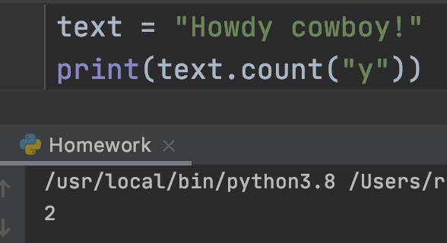
Count Method

Slide 6
Vowel counter
Take a string as an input
Iterate through the whole string and count how many vowels there are
Input: Hello
Output: 2
Homework: Make a consonant counter

Slide 7
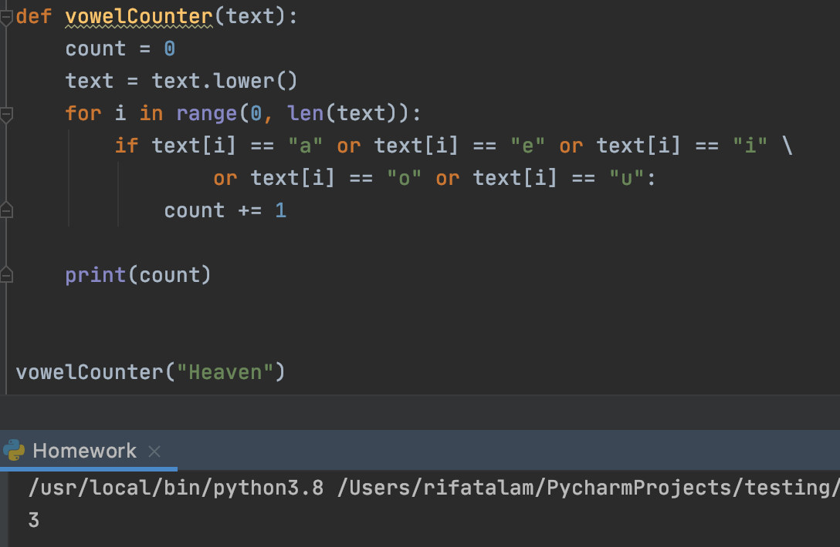
Solution

Slide 8
Turtle – visual coding
Python has a graphical library that we can use to draw on the screen
import turtle
Make a turtle variable: tom = turtle.Turtle()
Add code for whatever you want to do with turtle
The last line should be turtle.done()
https://repl.it/languages/python_turtle - online compiler

Slide 9
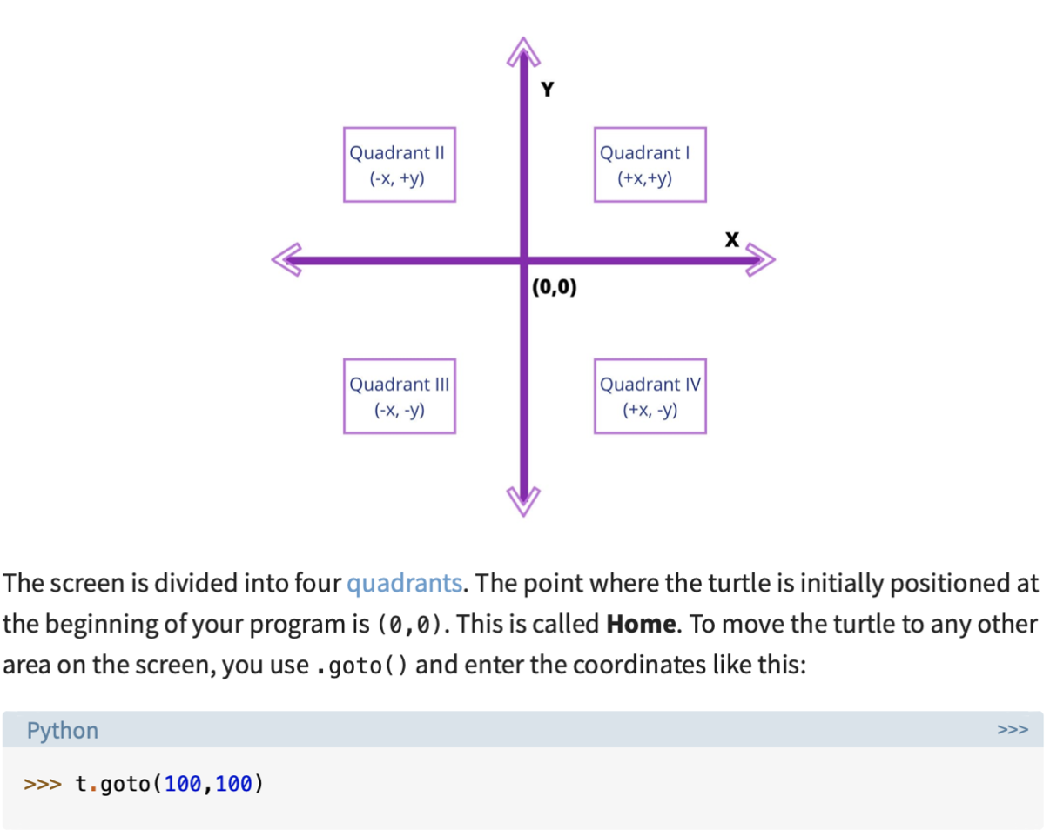
Coordinate system

Slide 10
Some basic turtle methods
forward(distance) – moves forward
backward(distance) - moves backward
left(angle) - turn left
right(angle) - turn right
penup() – don’t draw on screen
pendown() – draw on screen

Slide 11

Some more methods
turtle.title("My Program") – name the window what you want
home() – brings turtle back to (0, 0)
goto(x, y) – takes turtle to the specified coordinate
pensize(size) – changes the thickness of the drawing
pencolor(“color”) – changes the color of the lines
speed(“3”) – how fast it draws

Slide 12
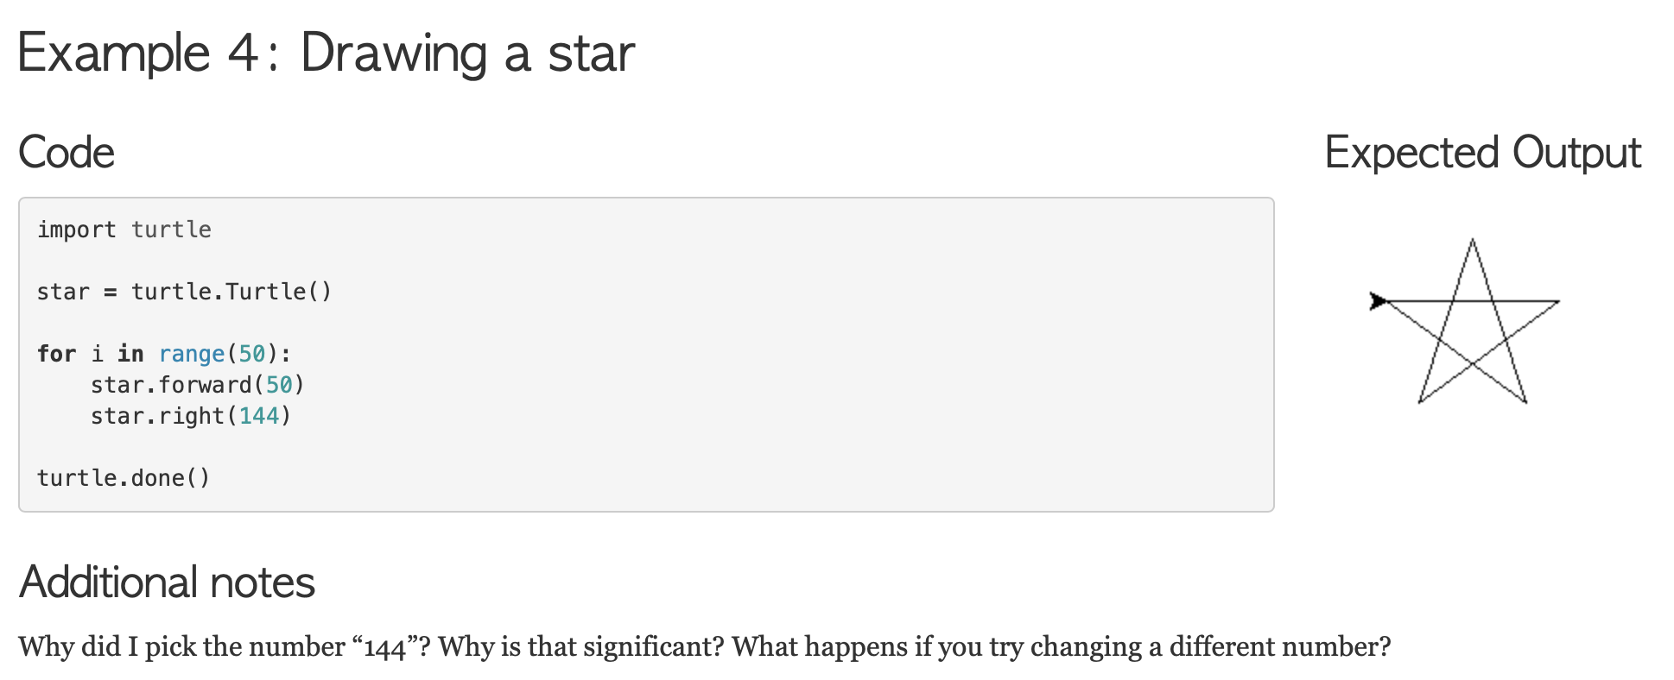
Some examples

Slide 13
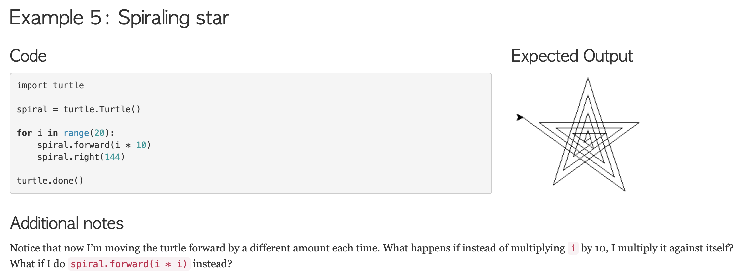
Examples

Slide 14
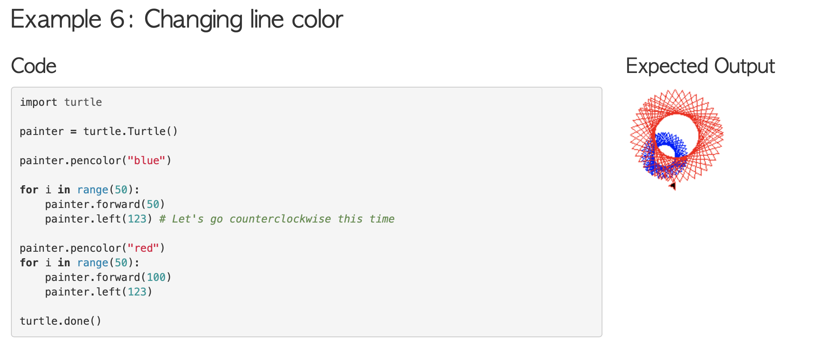
Examples

Slide 15
Homework
Make an illustration in Turtle
It can be anything as long as you do it yourself
Some examples would be drawing a maze, complex shapes, colorful drawings, making a scenery, easy animation

Slide 16
Tech Talk
CRISPR
https://youtu.be/6tw_JVz_IEc

